Slide 1

Crowdfunding Website
A Donation-Based Project Funding Platform
Web Developer: Ansh Patel
Department Name: IT
Roll No. : 202501100600026

Slide 2


Empathize
Understanding User Challenges in Crowdfunding Platforms
Research Objective
Through extensive user research and analysis of existing
donation-based funding platforms, we identified critical pain
points affecting both donors and campaign creators.
Trust Deficit
Information Overload
Many campaigns lack verification indicators and transparency measures, creating hesitation among potential donors about fund legitimacy.
Users feel overwhelmed by unclear categories and scattered information, making it difficult to find causes that matter to them.
Visibility Issues
Security Concerns
Campaign creators struggle to gain traction and maintain transparency about fundraising progress and fund allocation.
Donors demand secure payment options and regular updates on how their contributions are being utilized.
Empathy Goal: Create a transparent, trustworthy, and user-friendly donation platform that simplifies campaign discovery and enables secure, confident contributions.

Slide 3









Define
Problem Statement
Users need a transparent, organized, and secure crowdfunding platform where they can easily explore campaigns, understand their impact, and make donations without confusion or risk.
Trust Signals
Clear Categorization
Verified badges, campaign progress tracking, and regular updates to build donor confidence.
Structured organization across medical, education, social causes, startups, and more.
Simple Donation Flow
Secure Payments
Streamlined, intuitive process from campaign discovery to contribution completion.
Integrated payment gateway ensuring safe, encrypted transactions.
Design Goal: Develop a transparent and accessible platform offering campaigns with structured layouts, intuitive navigation, and real-time progress tracking that empowers both donors and creators.

Slide 4






Ideate
Brainstorming Solutions for an Enhanced User Experience
Campaign Verification System
Add verification badges and credibility indicators to build trust and reduce fraud concerns.
Smart Categorization
Implement intuitive categories and advanced filters for effortless campaign browsing and discovery.
Real-Time Tracking
Integrate dynamic donation tracking bars showing live progress toward funding goals.
Admin Moderation
Establish a robust system for campaign approval and quality control before publication.
Additional Innovations
Chosen Solution: A secure, intuitive crowdfunding platform with verified campaigns, streamlined donation workflow, and real-time progress updates.
Responsive grid-based layouts for campaign cards
Comment and update section for transparent communication
Multilingual support for broader accessibility
Mobile-first responsive design approach

Slide 5
Proposed Design Solutions & Features
Campaign Grid Layout
Verified Campaign Badges
Donation Progress Bar
Clean, organized display with intuitive category filters for easy browsing.
Trust indicators that reduce fraud risk and boost donor confidence.
Visual tracking of goals, amounts raised, and contributor counts.
🔒 Secure Payments
📱 Mobile-Responsive Design
Multiple gateway options including UPI, card, and digital wallets for flexible, safe transactions.
Seamless experience across all devices, from smartphones to desktop computers.
📊 User Dashboard
✏️ Campaign Updates
Comprehensive tracking of donations, viewing history, and saved campaigns in one place.
Creators can post progress images, milestones, and detailed impact reports.

Slide 6
System Modules
Comprehensive Platform Architecture
Module Name
Purpose / Functionality
User Module
Registration, login, profile management, and authentication
Campaign Creator Module
Create, edit, update, and verify campaigns with rich media support
Donor Module
Browse campaigns, donate securely, track contribution history
Category & Filter Module
Organizes campaigns based on goals, domains, and impact areas
Payment Module
Handles secure donations, transaction processing, and digital receipts
Admin Module
Approves campaigns, verifies details, monitors fraud, manages platform
Progress Tracking Module
Displays donation statistics, goal completion, and real-time updates
Notification Module
Alerts donors and creators about updates, milestones, and activities
Each module works seamlessly together to create a cohesive, powerful platform that serves the needs of all stakeholders while maintaining security and transparency.

Slide 7

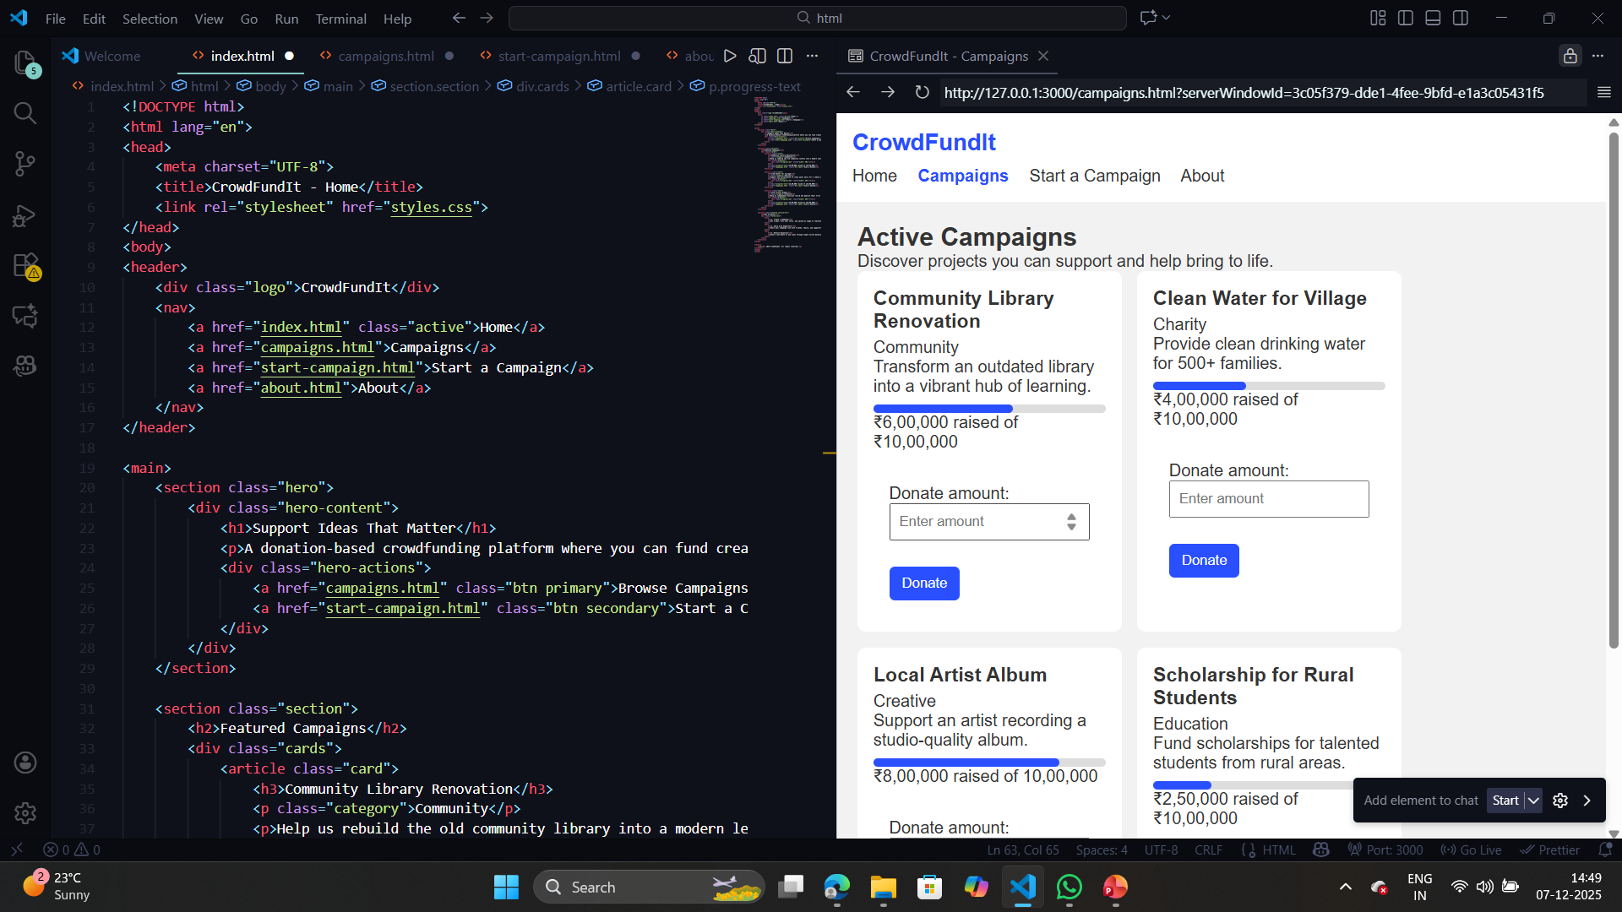
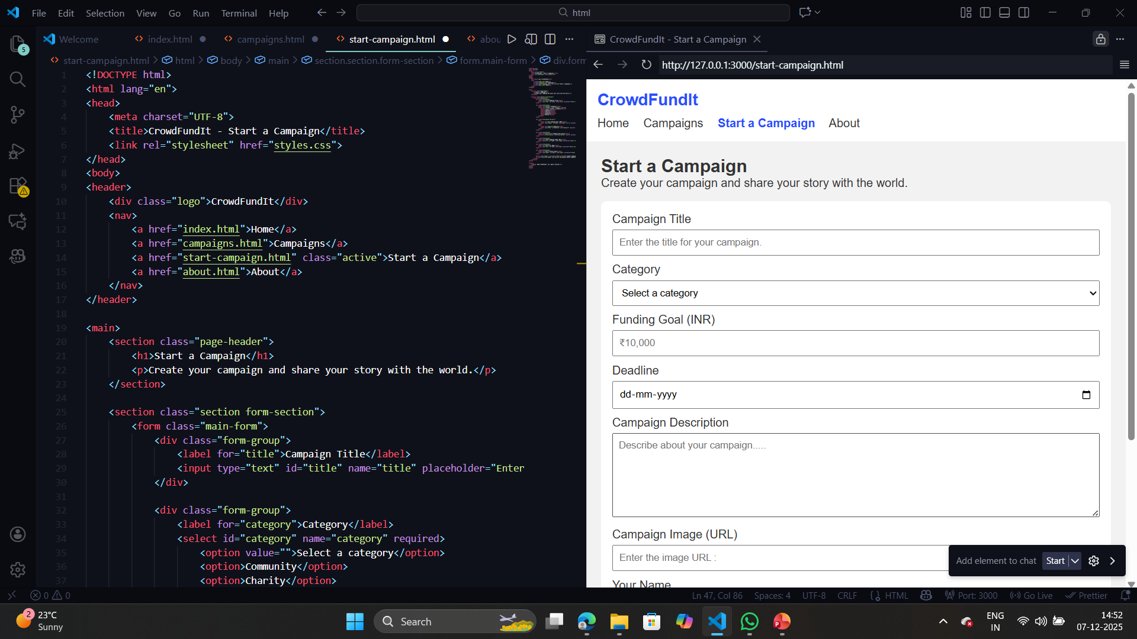
Thank You
Questions?
We welcome your thoughts, feedback, and questions about this crowdfunding platform design.

Slide 8

Conclusion
A Platform Designed for Impact
Our crowdfunding website simplifies donation-based funding by addressing core user needs and removing barriers to meaningful contribution. The platform ensures:
✅ Trust
Verified campaigns and transparent tracking
✅ Transparency
Real-time updates and progress visibility
✅ Ease of Use
Intuitive navigation and simple workflows
✅ Security
Protected payments and data privacy
This platform empowers people to support meaningful projects and causes effortlessly, creating lasting impact in communities worldwide.

